Slide 1



Capstone Project Phase 2
Secondhand website
Project number: 23-2-D-8
Advisor: Ronen Zilber
Othman Habib Allh -314934860
Laith Sadik-318679677
Date: 8/05/2024

Slide 2

Introduction
Developing a website project for a marketplace specializing in second-hand items.

Slide 3



Problem Description
Environmental Impact
Promoting recycling reduces waste, conserves resources, and mitigates environmental impact.
Technological Impact
A fragmented marketplace lacking a centralized platform for second-hand products poses challenges in establishing efficient connections, trust, and verification.
Financial Impact
The high cost of new products can be prohibitive, particularly for individuals with limited budgets.

Slide 4



Solution Description
Environmental Perspective
Our project tackles waste by promoting reuse, reducing the demand for constant production, and thereby combating climate change and resource depletion.
Technological Perspective
Through a centralized marketplace with robust verification systems, our project establishes trust and Confidence among buyers, addressing concerns about quality and authenticity in the second-hand market.
Financial Perspective
Our platform provides affordable second-hand goods, alleviating the high cost.

Slide 5









Client-Server Technologies:

Slide 6






Front-End Technologies
We used React.js, a popular JavaScript framework for building user interfaces.
CSS Tailwind was instrumental in styling our website, and design it.
To manage our application's state in a predictable way, we employed Redux Toolkit.
For secure user authentication and authorization, we implemented JSON Web Tokens (JWT) with cookies.

Slide 7



Back-End Technologies
utilized Node.js with Express.js, a powerful combination for building scalable and efficient web applications.
For our database needs, we chose MongoDB, a flexible and scalable NoSQL database.
We utilizes Firebase for Google authentication login Also for image storage.

Slide 8
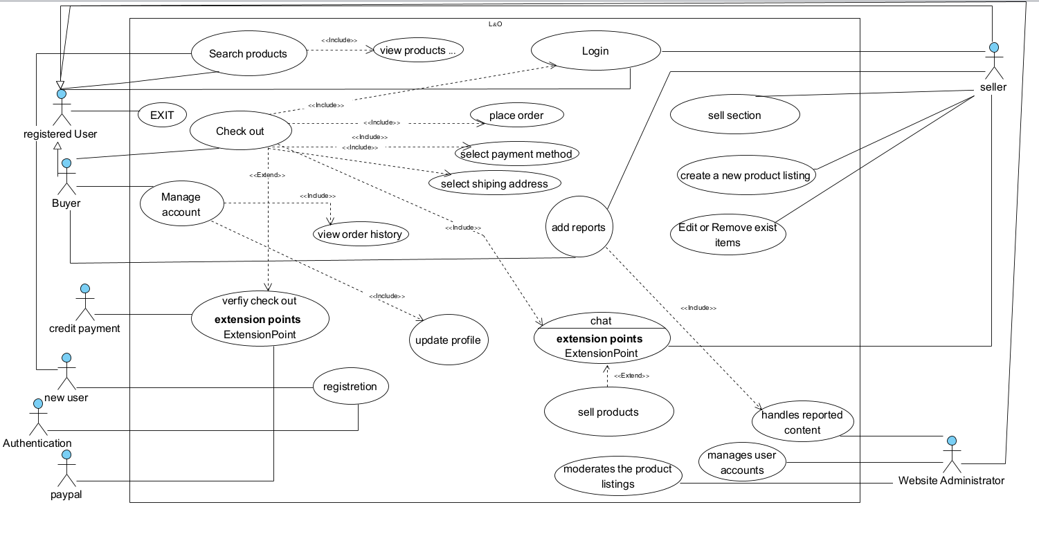
Use Case Diagram

Slide 9
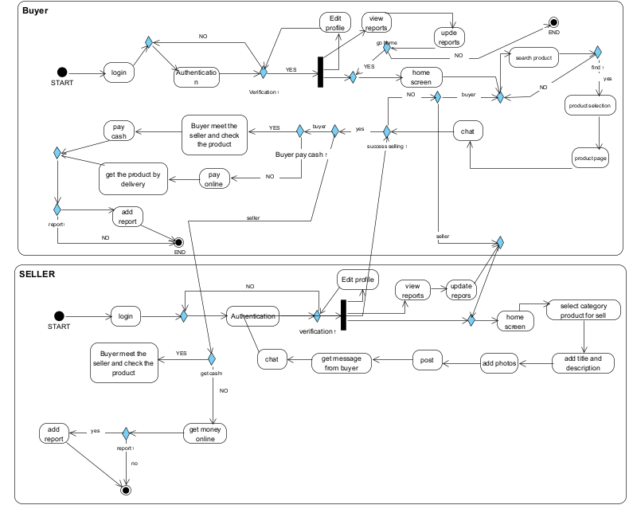
Activity Diagram

Slide 10
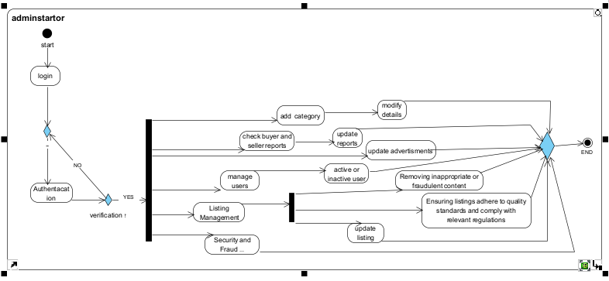
Activity Diagram

Slide 11
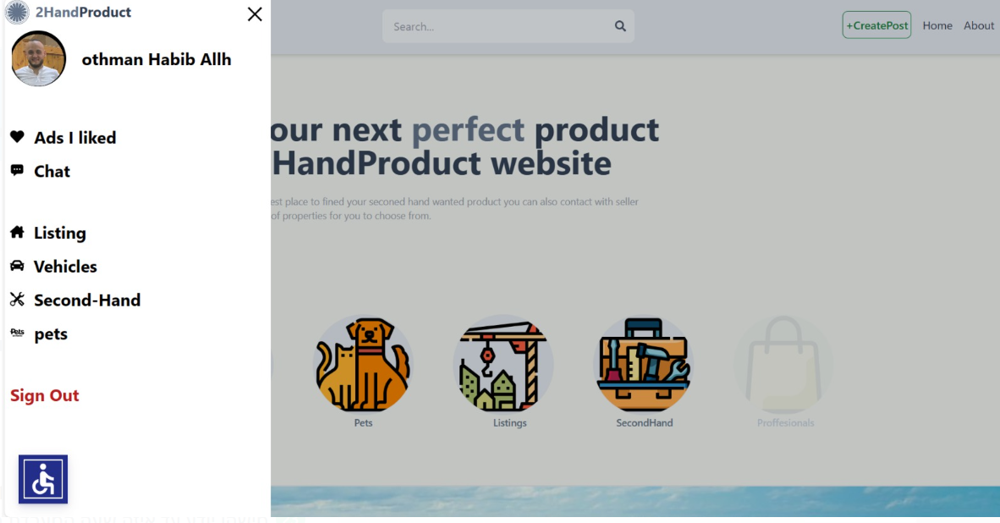
Our website screens
Home Page:

Slide 12
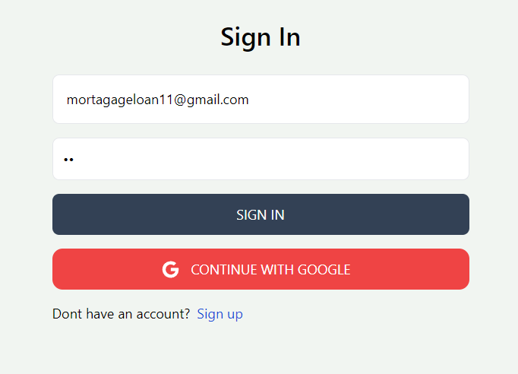
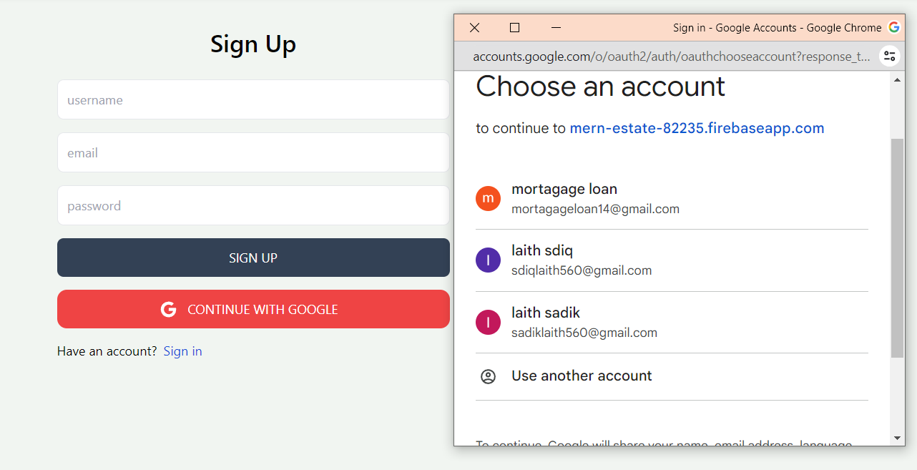
Our website screens
Log-in Pages:

Slide 13
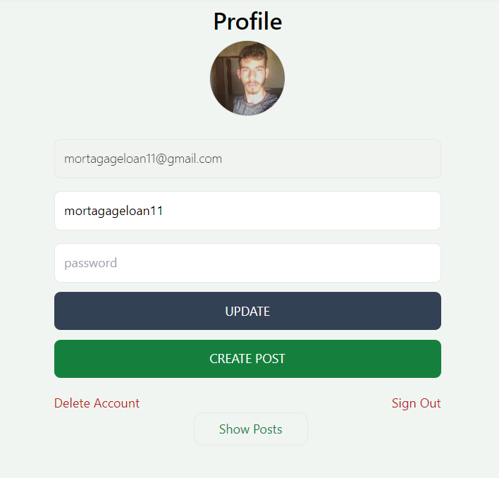
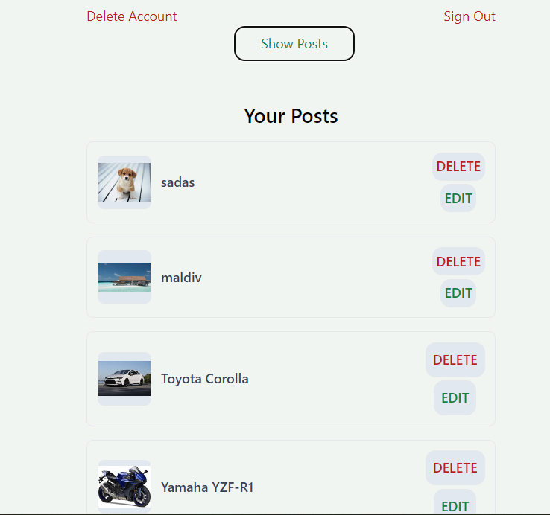
Our website screens
Profile Pages:

Slide 14
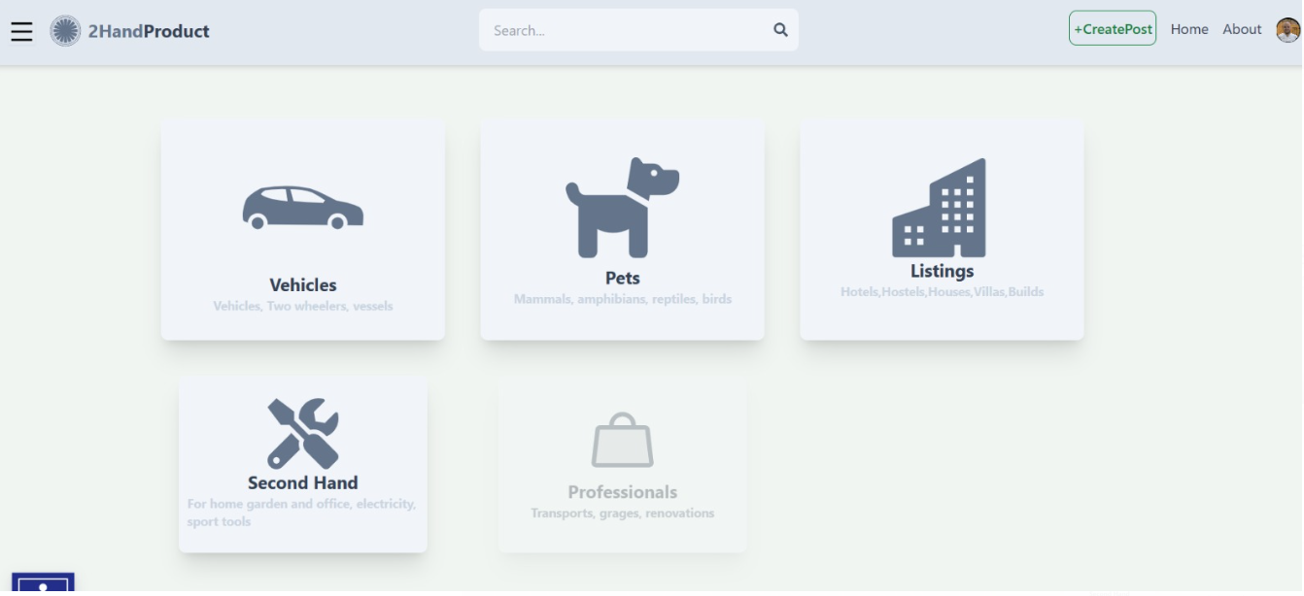
Our website screens
Create-Post Pages:

Slide 15
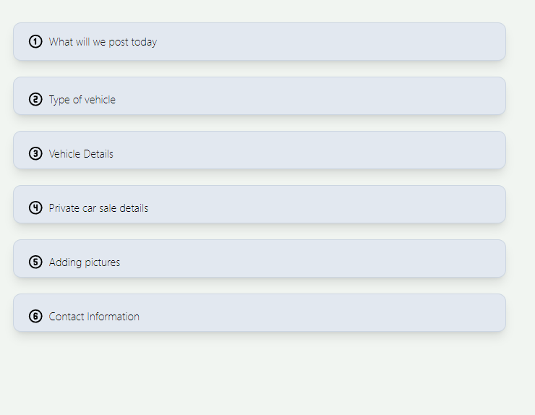
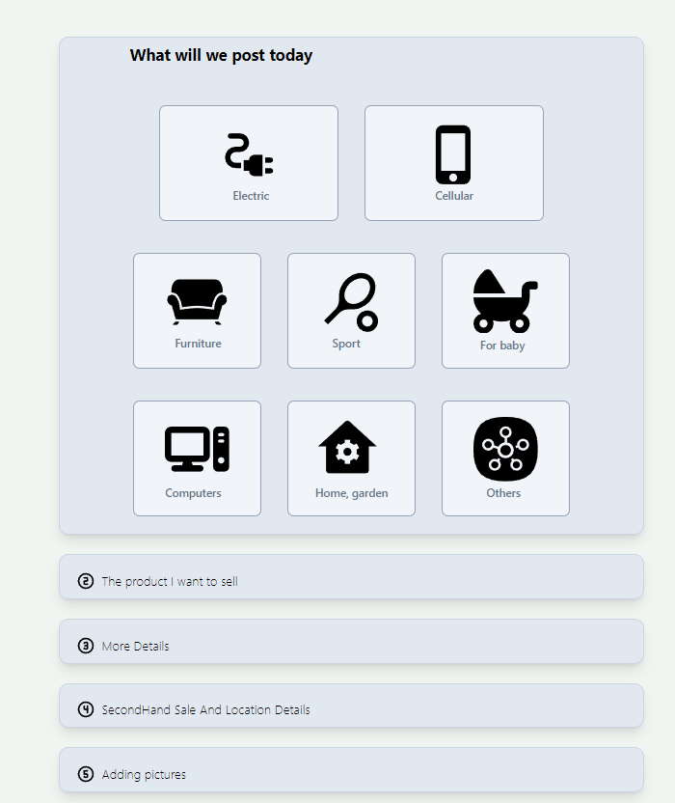
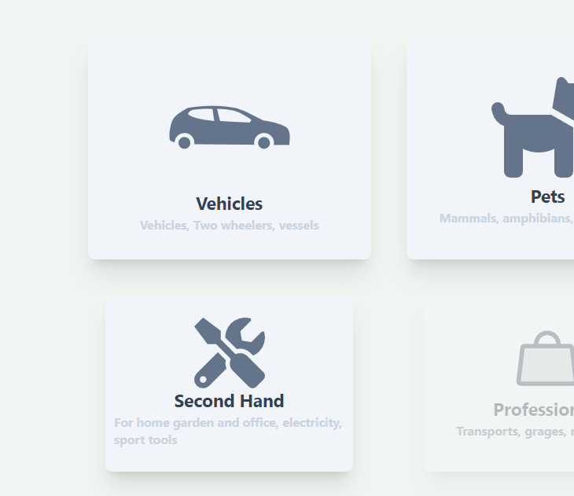
Our website screens
Create-Post Pages:

Slide 16
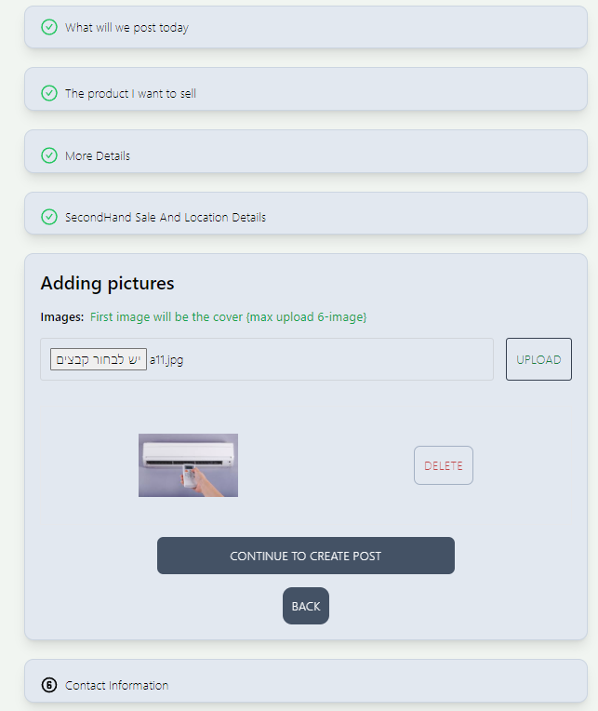
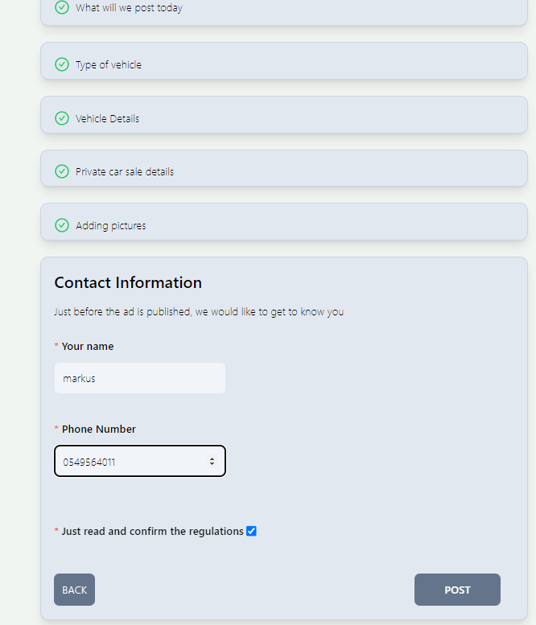
Our website screens
Create-Post Pages:

Slide 17
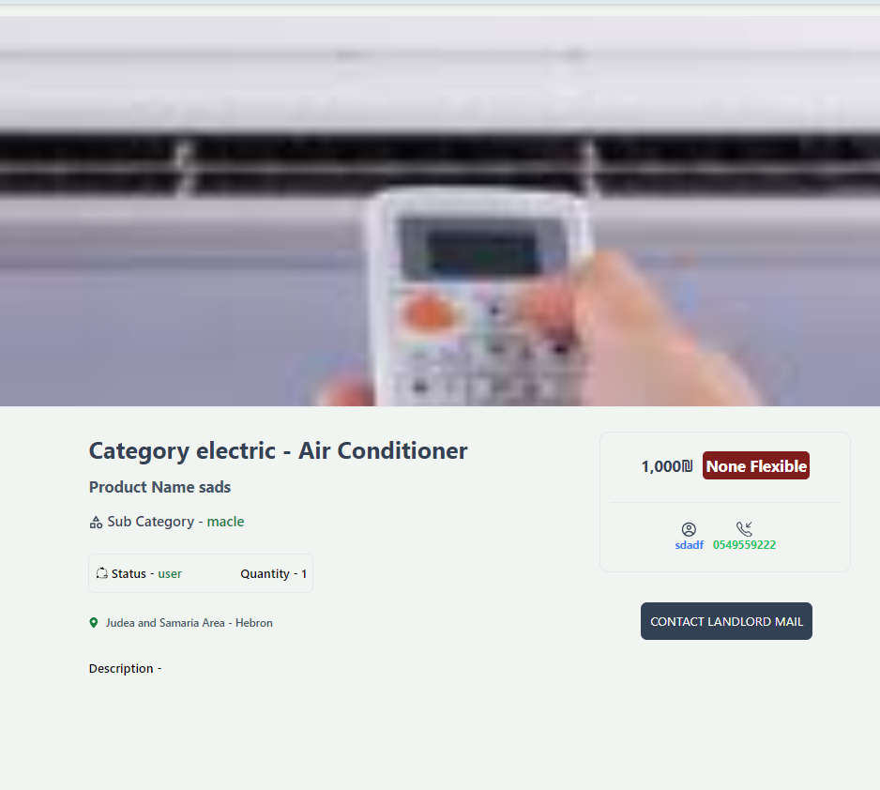

Our website screens
Post Pages:
After the user completes the post, they will see their post on the website.

Slide 18
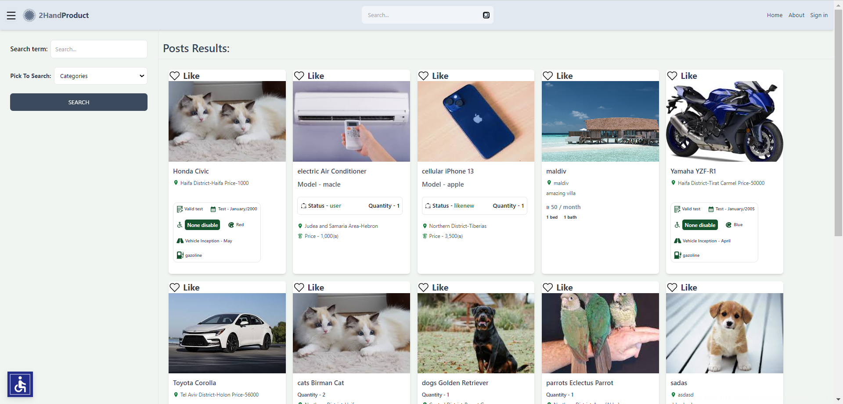
Our website screens
Search Pages:

Slide 19
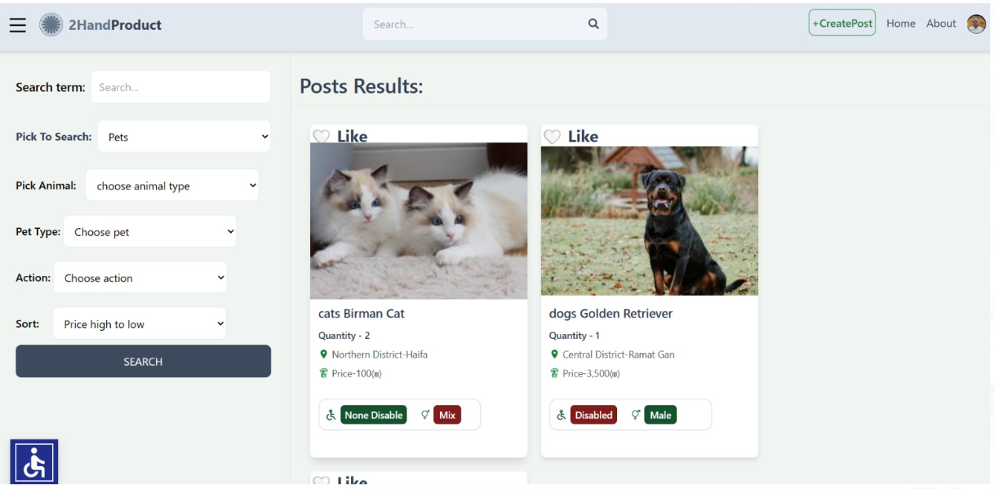
Our website screens
Search Pages with filter:

Slide 20
User’s Guide Operating Instructions video
https://drive.google.com/drive/folders/1s5RknHDScGgbzZVxiSSRlY3U-ptBmY_Q?q=sharedwith:public%20parent:1s5RknHDScGgbzZVxiSSRlY3U-ptBmY_Q
LINK YOUTUBE IF THE DRIVE LINK DID NOT WORK
https://www.youtube.com/watch?v=gvO6q28hvsI

Slide 21






Website security
input validation: importance of input validation to prevent security vulnerabilities like SQL injection and cross-site scripting (XSS).
Authentication and authorization: secure authentication mechanisms JSON Web Tokens (JWT) and Cookies.
Regular Security Updates: staying up to date with security patches and updates for servers, frameworks.
Protection Personal Information: using encryption algorithms (bcrypt lib) to ensure the confidentiality of sensitive data both during storage and transmission.

Slide 22
Unit Tests Some Example
#No​ | Test Subject​ | Expected result​
Login form​
1​ | Enter an empty username or password​ | Error displays a message: “Please fill in the fields”.​
2​ | Enter the wrong username or password​ | Error displays a message: “Invalid details, try again”​ We don’t want to give information about which field is invalid.​
3​ | Log in with a ‘frozen’ status username and password​ | Display message: “User is Frozen”.​
4​ | Enter a valid username and password​ | Display message:” Login succeed”.​

Slide 23
Unit Tests Some Example
No#​ | Test Subject​ | Expected result​
the user performs a product advertising operation on the website
5​ | Uploading Multiple Product Images | The uploaded images are correctly associated with the listing and displayed on the listing's page.
6​ | Invalid Price Format | The listing submission failed with an error message stating that a valid price format is required.
7​ | Enter valid details​ | Display a message: “Registration succeed, please wait for approvement”.​ ​

Slide 24
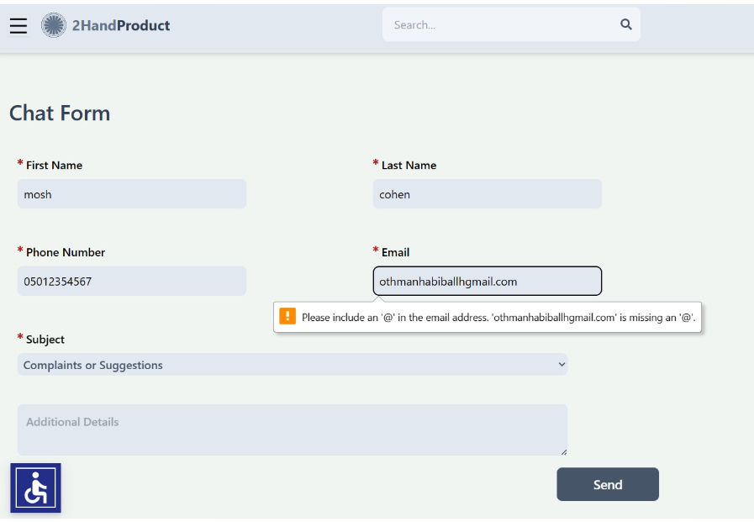
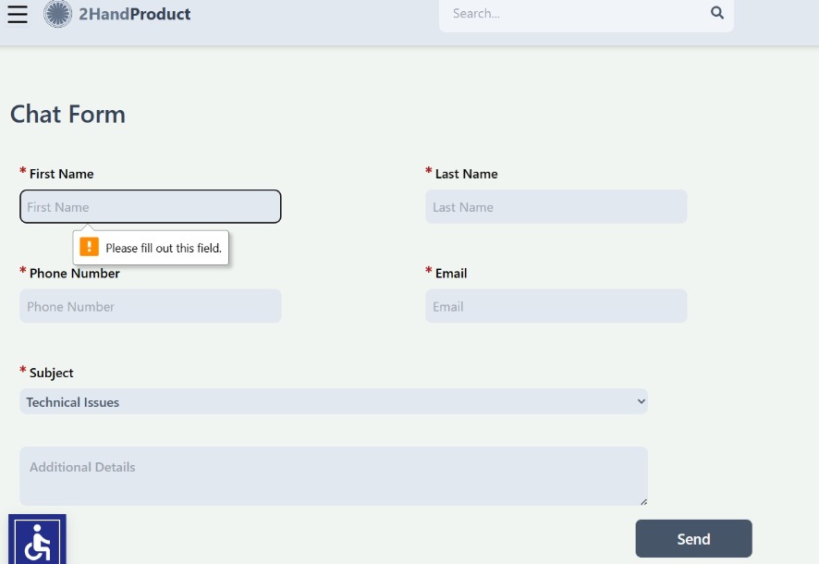

Slide 25


Problems We Faced
Search Functionality: Implementing an efficient search feature that could handle a large number of listings and deliver accurate results was challenging.
Image Handling: Managing and displaying images for each listing posed a challenge, especially in terms of storage and loading times.
Responsive Design: Creating a responsive design that looked great and functioned well on all devices was a challenge
Deploy the website: Deploying the website to run on the cloud was the most challenging aspect of the project.

Slide 26
Thank you for listening

